Slide 1
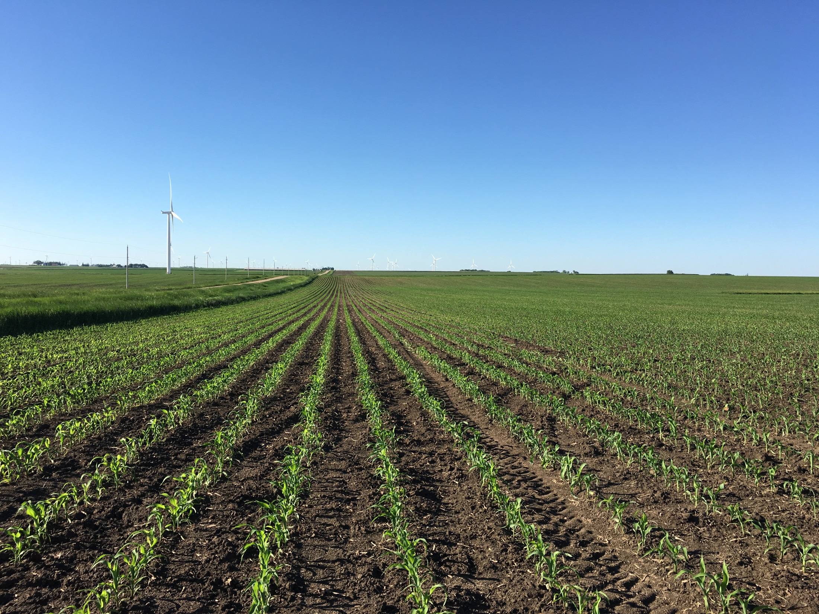
FRST Lime Project
Update
Robert Miller,
Former Professor Colorado State University
ALP Program Technical Director,
Windsor, CO
February 23, 2023
Miller, 2023

Slide 2
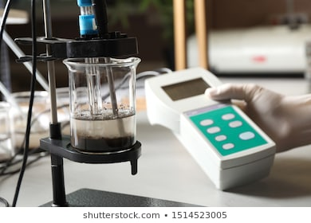
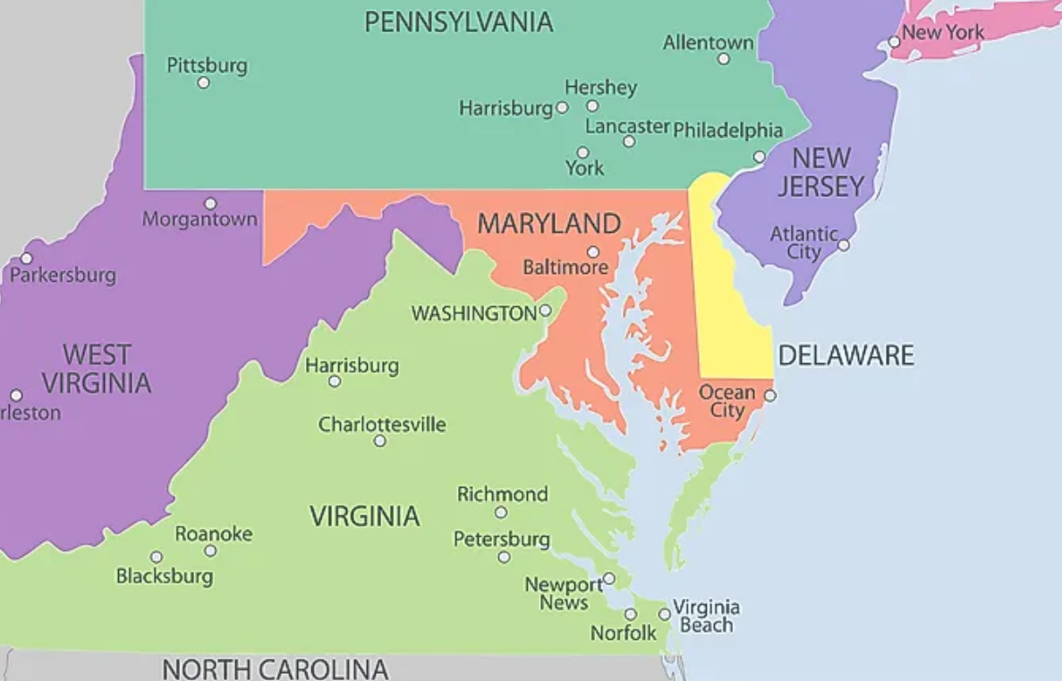
Soil pH methods, Mid-Atlanitc Region
Measurement of active acidity, ISE
pH _{(1:1)} _{H2O}
pH _{(1:1) 0.01 M CaCl2}
pH (1:1) H₂O = pH (1:1)_{CaCl2} + 0.4
* Soil pH by the salt method has increased in recent decades to address low ionic strength soil slurry solutions and improve precision.
MASTPAWG
FRST Lime Project
February 23, 2023
Miller, 2023
Notes:
IN north America ther are primarily 7 method for measuring soil pH dependent othn the soil water ratio and the use of salt solutions.
Metherods are regionally specific. pH salt methods hage increased in recent decades as the have proven to be more preecsioe
Meauremetn uncertianty

Slide 3
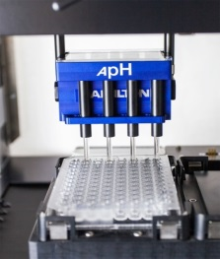
Soil BpH methods, Mid-Atlantic Region
Measurement of reserve acidity
Adams Evans BpH ¹ (mimic replacement Moore-Sikora)
SMP BpH ² (mimic replacement by Sikora)
Mehlich BpH_{mod}
¹ Moore-Sikora BpH method was developed in 2008 mimic Adams Evans to replace hazardous chemical reagents of the method, limited adoption.
² The Sikora BpH method was developed in 2002 mimic SMP to replace hazardous chemical reagents of the SMP method, has been widely adopted.
MASTPAWG
FRST Lime Project
February 23, 2023
Miller, 2023
Notes:
Therir are nine soiul BpH being across the US and their development of BpH methods over the past 70 years are based regional research.
SMP developed in OH, is used domiantely in the Miodwest. The Sikora develed by Dr Frank Sijora at Univ KY, mimics the SMP using non hazardous reagents
The Adams Evan si domintely used in soils of the southeast, low in CEC.
The Mehlich Buffer and its modified was developed at NC State and is based
The Sikora 2 is modification
And the Univ of Gerogia utilizes a titration of acidity with Ca hydroxide

Slide 4
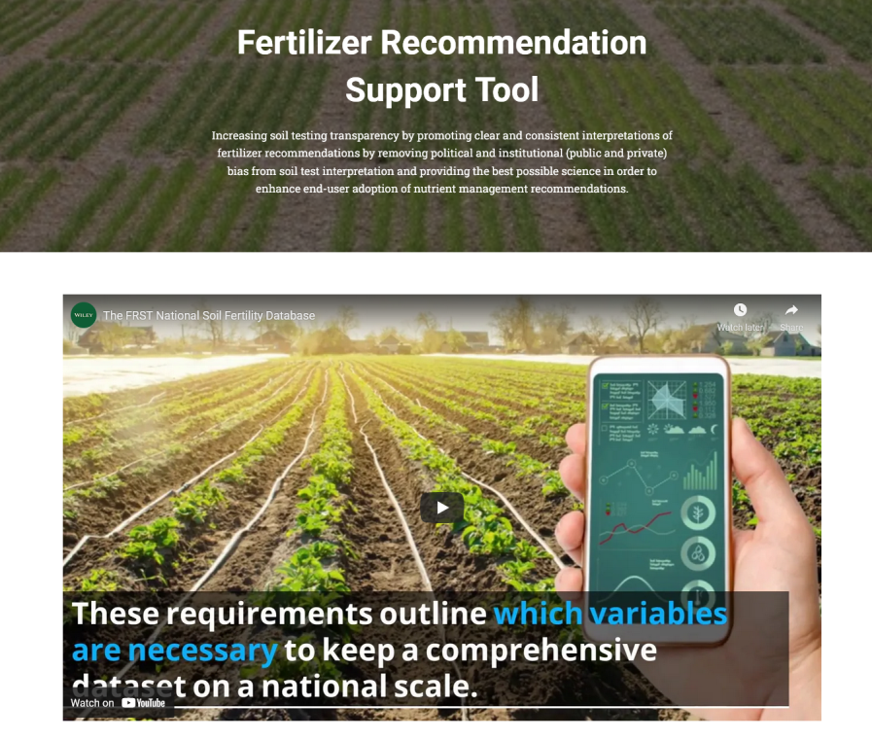
FRST Project
The FRST (Fertilizer Recommendation Tool) was initiated in 2016 to develop promote clear and consistent soil testing interpretations of fertilizer recommendations for nutrient management, and act as a catalyst for innovation.
The FRST project team is comprised of university and government researchers across the US. Initially FRST has focused on P and K soil test calibration and recommendations. Additional projects have focused on soil sampling and a SOP for conducting P and K calibration research.
In January 2022 established the FRST Lime Project.
soiltestfrst.org
MASTPAWG
FRST Lime Project
February 23, 2023
Miller, 2023

Slide 5
FRST Lime Project Team
Brian Arnall Oklahoma State University
Steve Culman Washington State University
Luke Gatiboni North Carolina St University
David Hardy North Carlonia Dept of Ag
Joseph Heckman Rutgers University
Sindhu Jagadamma University of Tennessee
Clain Jones Montana State University
John Jones University of Wisconsin
Emileigh R Lucas University of Maryland
Quirine Ketterings Cornell University
Jay Lessl University of Georgia
Andrew Margenot University of Illinois
Robert Miller Colorado State University
Amber Moore Oregon State University
Stephanie Murphy Rutgers University
Rao Mylavarapu University of Florida
Bryan Hopkins Brigham Young University
John Spargo Penn State University
Nathan Nelson Kansas State University
Deanna Osmond North Carolina St University
Rasel Parvej Louisiana State University
Tim Pilkowski USDA-NRCS
Manbir Rakkar Montana State University
Ed Rayburn West Virginia University
Dorivar Ruiz Diaz Kansas State University
Kurt Schroeder University of Idaho
Amy Shober University of Delaware
Frank Sikora University of Kentucky
Nathan Slaton University of Arkansas
Jared Spackman University of Idaho
Haiying Tao University of Connecticut
Gurpal Toor University of Maryland
Matt Yost Utah State University
Hailin Zhang Oklahoma State University
Shannon Alford Clemson University
MASTPAWG
FRST Lime Project
February 23, 2023
Miller, 2023

Slide 6
FRST Lime Project
The FRST Lime Project team has monthly meetings with the initial goal establishing a knowledge base line of soil acidity. The project has generated six mini seminars on the measurement of soil pH and Buffer pH, and is developing a national research project to address soil acidity and lime recommendations.
Monthly recordings of Lime project meetings will be uploaded to the FRST project: http://www.soiltestfrst.org/
MASTPAWG
FRST Lime Project
February 23, 2023
Miller, 2023
Notes:
Read bullet points

Slide 7
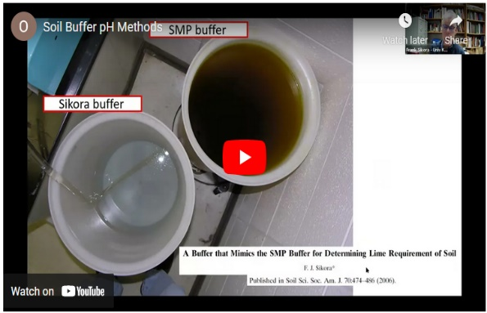
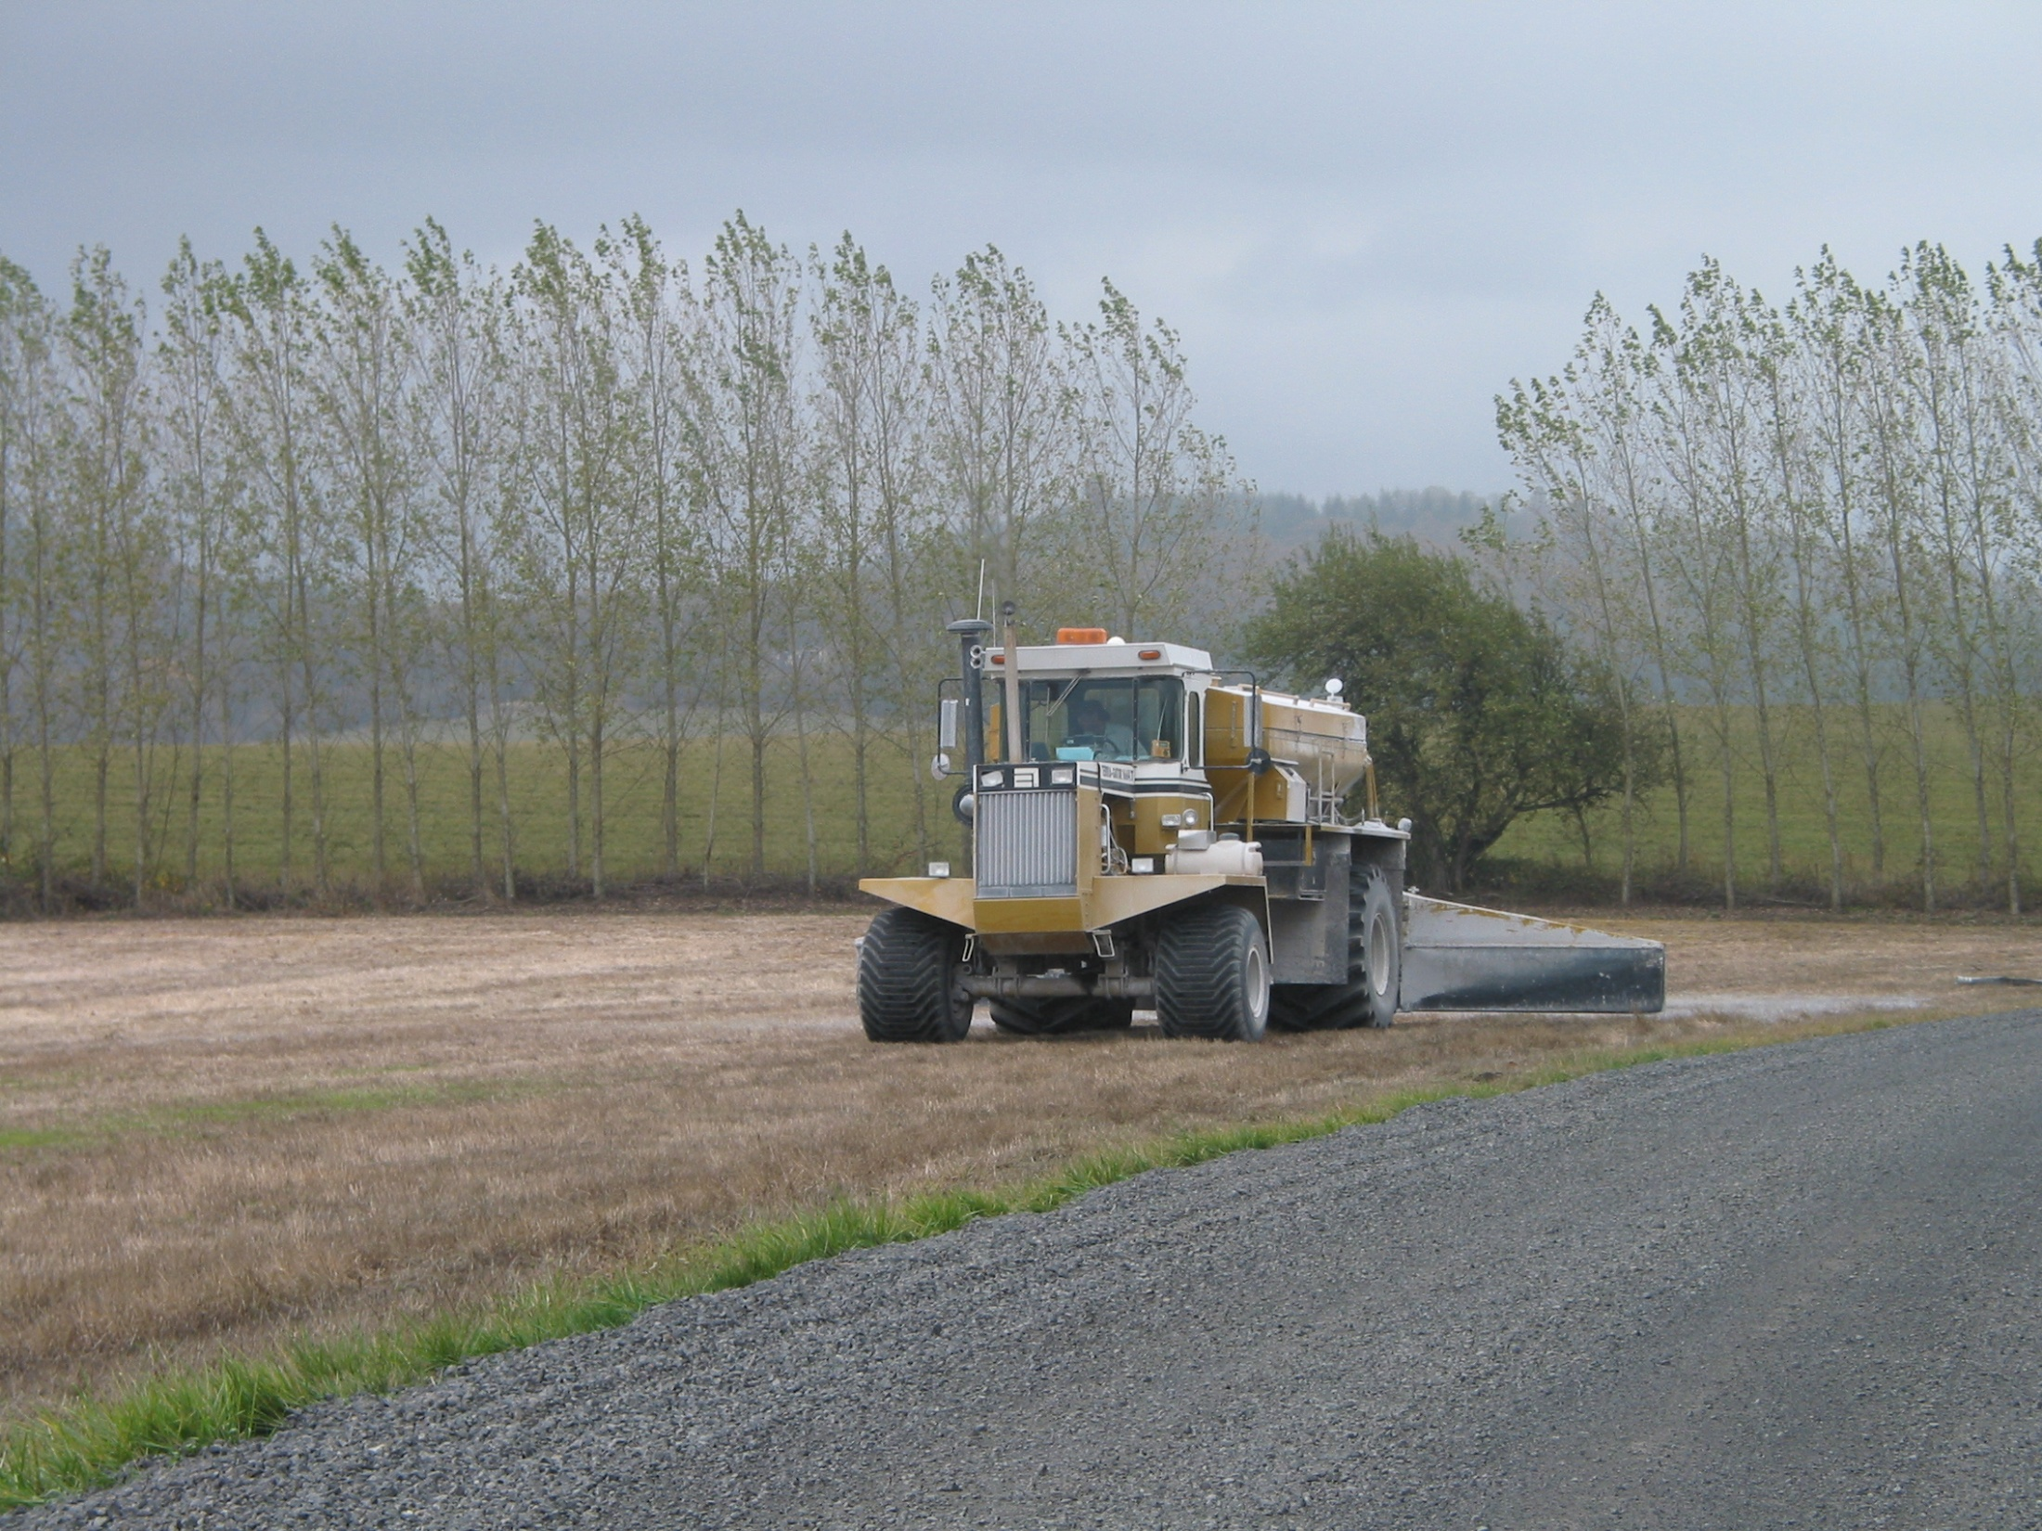
FRST Lime Project: presentations
pH overview
Soil acidity
Soil pH methods
Soil BpH method
Lime incubation
Lime calibration
soiltestfrst.org/lime/
MASTPAWG
FRST Lime Project
February 23, 2023
Miller, 2023

Slide 8
FRST Lime Project objectives
Identify current US soil pH and buffer methods and lime recommendations and identify inconsistencies.
Discuss and plan development unified soil lime recommendation(s) for North America.
Establish a multi-year research project to assess soil acidity and generate new lime recommendations through lab analysis, incubation studies and field validation.
Develop grant support through industry, government and commercial interests to generate new soil lime recommendations.
Develop state-level extension programs to educate agronomists, consultants and practitioners on soil acidity and lime recommendations.
MASTPAWG
FRST Lime Project
February 23, 2023
Miller, 2023
Notes:
Read bullet points

Slide 9
FRST Lime: Obj #1 survey of recommendations
ALP soil pH and BpH data for six proficiency soils was submitted to 32 LGU labs for lime recommendations.
Soils pH ranged in pH 4.05 – 5.89. Sikora BpH ranged from 5.90 to 6.90. AE BpH 6.98 – 7.59. Soil clay ranged 7 – 31%.
Recommendation base on 0-6“ soil depth, target pH 6.50 and 100% ECCE.
ALP Soil ID | pH _{1:1 H2O} | AE BpH | CEC
 |  |  | cmol kg⁻¹
SRS-2113 | 4.05 | 7.52 | 5.1
SRS-2102 | 4.23 | 7.28 | 6.6
SRS-1614 | 4.60 | 6.98 | 18.4
SRS-1903 | 5.36 | 7.43 | 13.4
SRS-1604 | 5.52 | 7.59 | 12.3
SRS-2115 | 5.84 | 7.46 | 12.7
John Jones, Univ WI
MASTPAWG
FRST Lime Project
February 23, 2023
Miller, 2023

Slide 10
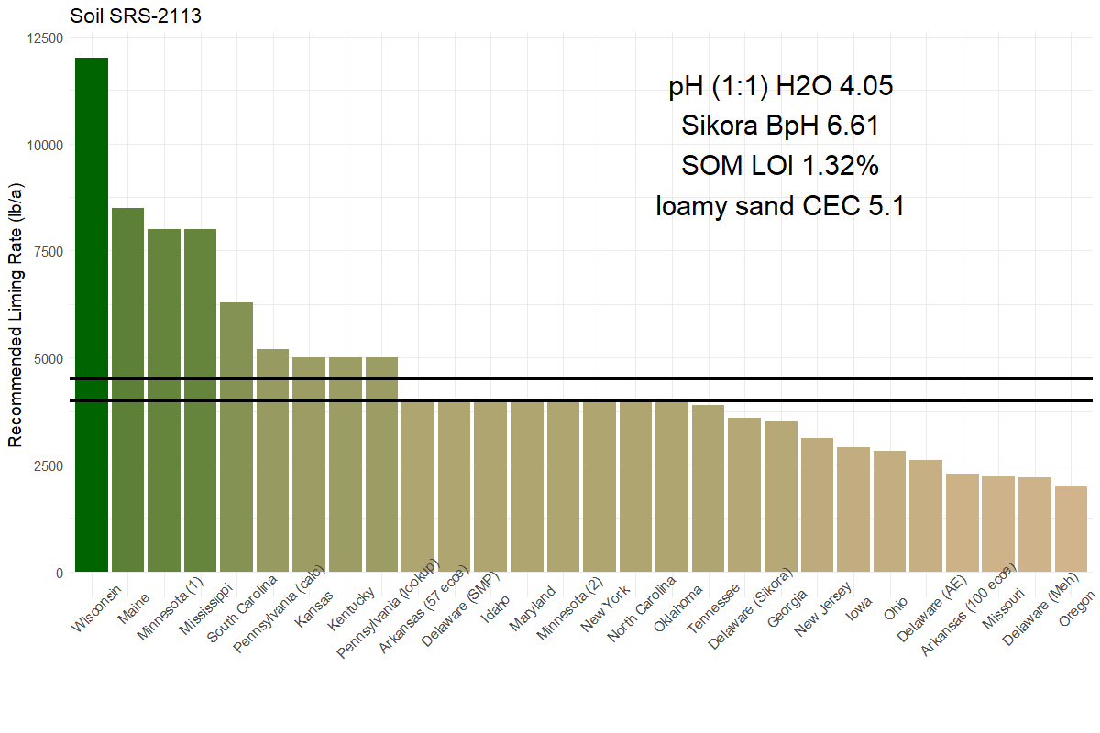
Lime recommendations by state – Soil a
John Jones, Univ WI
Mid-Atlantic Region (DE, MD, PA, NJ)
mean = 4506
median = 4000

Slide 11
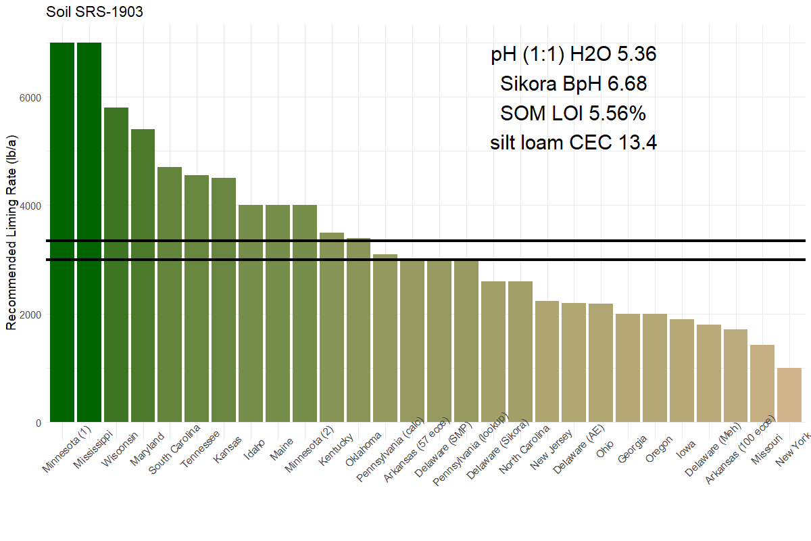
Lime recommendations by state – Soil d
John Jones, Univ WI
Mid-Atlantic Region (DE, MD, PA, NJ)
mean = 3343
median = 3000

Slide 12
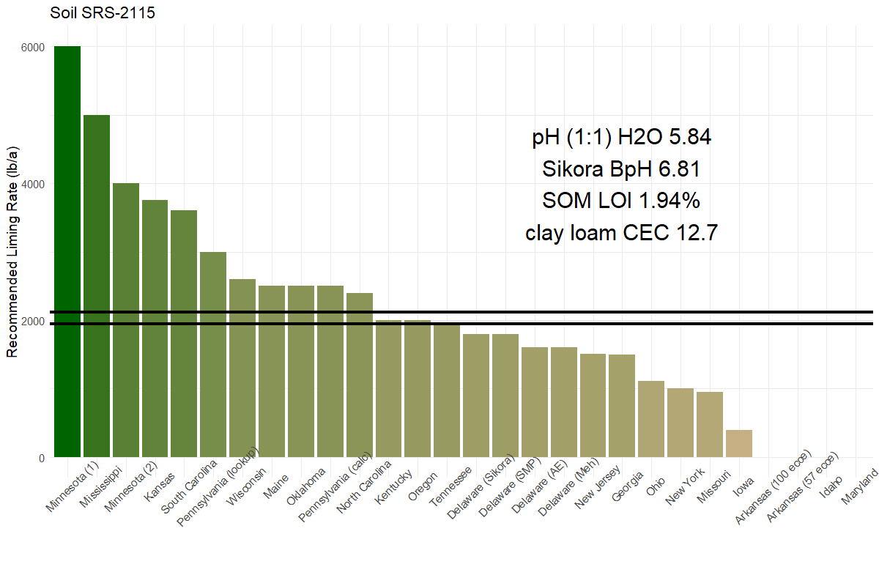
Lime recommendations by state – Soil f
Mid-Atlantic Region(DE, MD, PA, NJ)
John Jones, Univ WI
mean = 2114
median = 1950

Slide 13
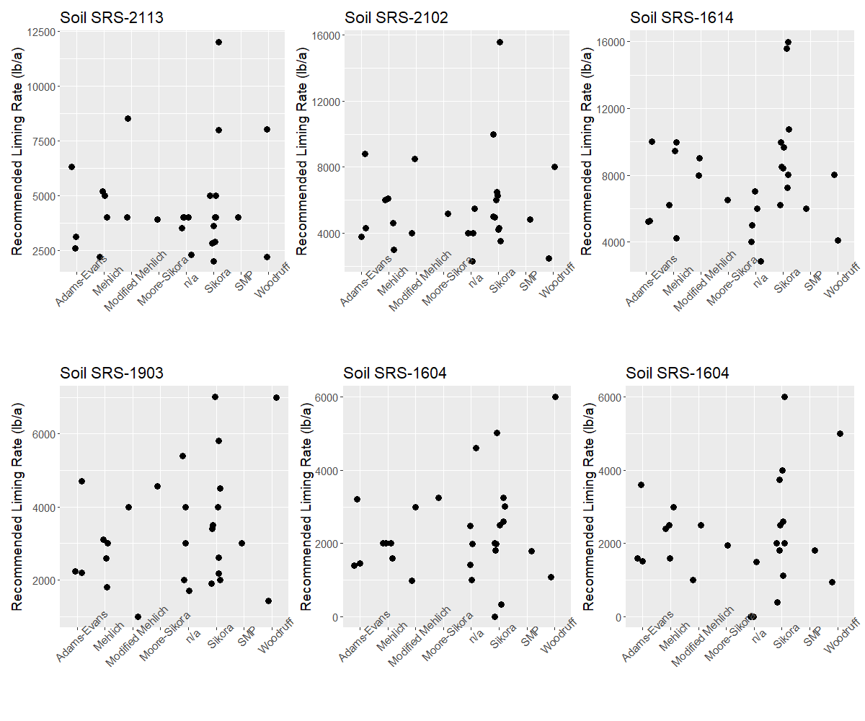
John Jones,
Univ WI

Slide 14
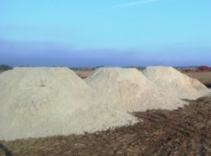
Lime Rec survey summary
Mid-Atlantic lime recommendations were generally consistent for the loamy sand texture soil (SRS-2113). pH 4.05, ranging 2500 - 4000 lbs/ac ECCE, with a median of 4000 lbs/ac.
Liming recommendations for the silt loam (SRS-1903). pH 5.36 indicated a majority of Mid-Atlantic recommendations were 2200 - 3000 lbs/ac ECCE, with one of 4800 lbs/ac.
It should be noted LGU lime recommendations from the survey were developed on soils within each state over the past 50 years and based on unique specific state and temporal calibrations.
Jones, 2022

Slide 15
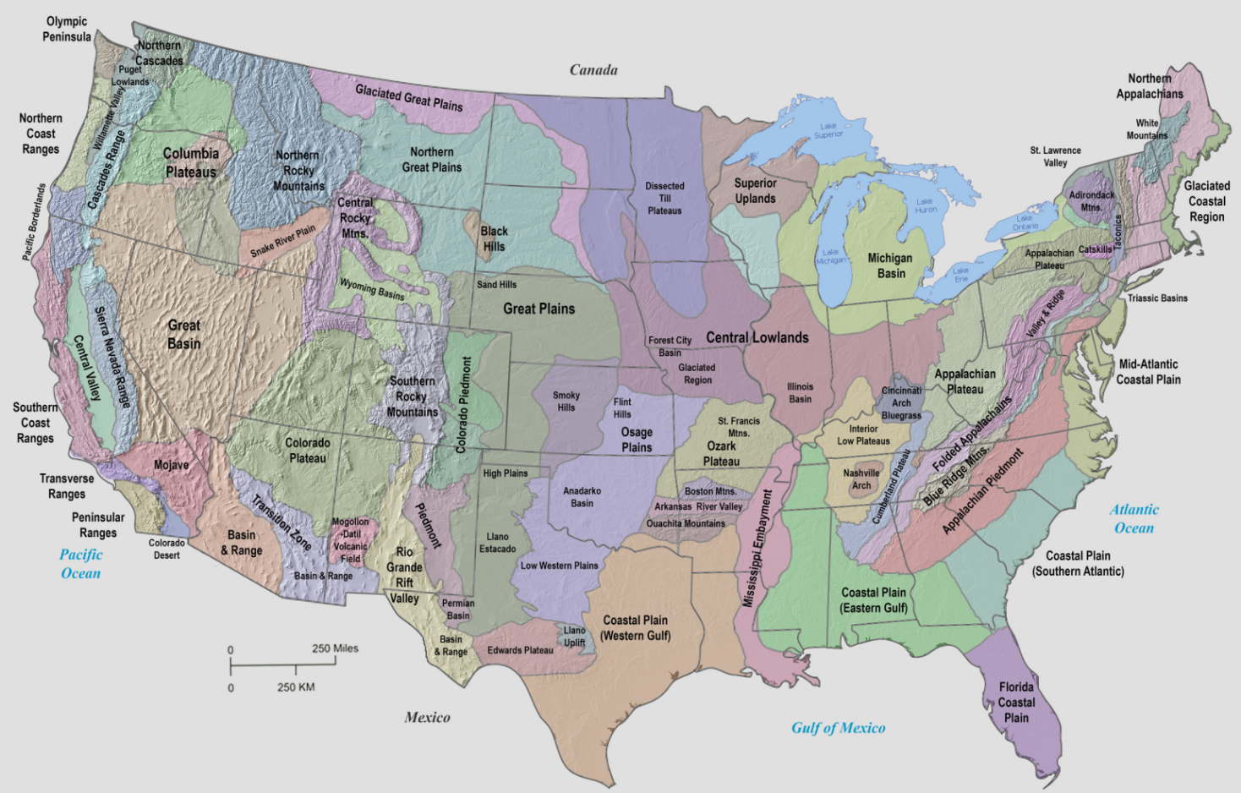
FRST Lime: Obj #2 incubation study
Collect 120 soils across the US representing major soil physiographic units across the four major soil regions (WERA-102, SERA-6, NEC-67 NECRA-13. Soils ranging in pH_{(1:1) H2O} 4.0-6.4, loamy sand to clay loam, CEC, SOM and mineralology. In progress
Soil acidity is independent of soil type or location.
MASTPAWG
FRST Lime Project
February 23, 2023
Miller, 2023

Slide 16
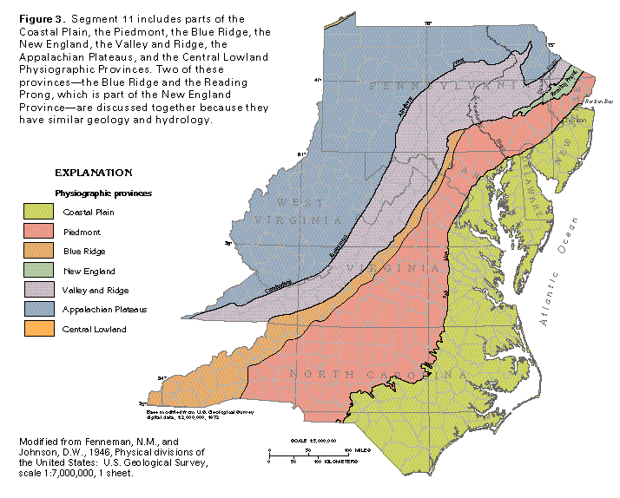
FRST Lime soils
Collect soils representing the primary physiographic units of the Mid-Atlantic: Costal Plain, Piedmont, Valley Ridge and Appalachian Plateau.
Focus on agronomic soils which ranged in: pH 4.0 – 6.40, SOM content, CEC and texture.
MASTPAWG
FRST Lime Project
February 23, 2023
Miller, 2023

Slide 17
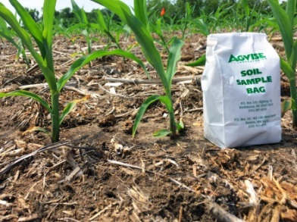
FRST Lime: Incubation study
In progress
Soil bag
Collected 120 soils across US based on physiographic unit. Meta data to include, depth, GPS, soil map unit, crop and fertilizer history.
Soil analysis: pH (2 methods), BpH (5 methods), M3 analytes, SOM, SOC, CEC, texture, titratable acidity, and exch Al.
Lime incubation study: 7 rates of lime application, source Ca(OH)₂, equilibration, and assess impact of lime on pH and NO₃-N.
Pilot study to evaluate alkaline source and time
MASTPAWG
FRST Lime Project
February 23, 2023
Miller, 2023

Slide 18
FRST Lime Project: Incubation study
Soil bag
Develop lime recommendation algorithms based on each of the four primary buffer pH methods (Sikora, Adams Evans, Modified Mehlich and Sikora-2). Pilot lime incubation study is in progress.
Evaluate the potential of mult linear regression model for estimating lime recommendation based on routine measured soil parameters: pH cations and SOM.
Verify lime recommendation algorithms on 12 new soils.
Miller, 2023

Slide 19
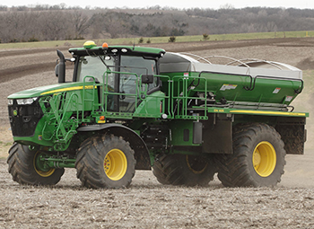
FRST Lime Project: support
Soil bag
The FRST project initial support through a USDA grant and is funding lime project soil collections for the initial incubation research.
Additional support will be needed to complete soils analysis, incubation research and data analysis.
Support will be sought from the fertilizer industry, lime manufacturers and commodity workgroups.
MASTPAWG
FRST Lime Project
February 23, 2023
Miller, 2023

Slide 20
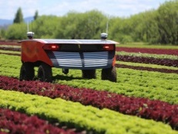
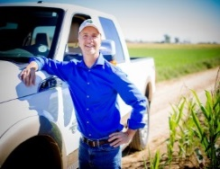
http://uh.edu/engines/3091-Fraunhofer_lines.svg.png
Thank you for your time
and attention
E-mail:
Robert.Miller@cts-interlab.com
Txt: 970-217-2572
http://upload.evocdn.co.uk/fruitnet/uploads/asset_image/2_1208010_e.jpg

Slide 21
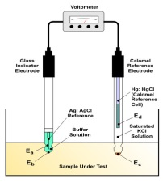
Comparison of soil BpH methods
Soil ID¹ | Soil Parameter
 | pH _{(1:1) s} | Sikora | AE | Meh_{Mod} | SOM | CEC
 |  |  |  |  | % | cmol kg⁻¹
SRS-1706 | 5.02 | 7.07 | 7.70 | 6.30 | 1.2 | 2.7
SRS-1511 | 5.05 | 6.84 | 7.62 | 6.20 | 2.2 | 6.7
SRS-1609 | 5.01 | 6.70 | 7.53 | 6.18 | 2.5 | 10.1
SRS-1215 | 5.06 | 6.35 | 7.35 | 5.90 | 3.7 | 18.8
Delta across 4 soils:
0.72
0.35
0.40
¹ Selected soils from ALP Program, parameter median values, pH range 5.01-5.06, Extr Al 1.7-5.2 ppm.
MASTPAWG
FRST Lime Project
February 23, 2023
Miller, 2023

Slide 22
Soil BpH lime calibration
Example
BpH lime recommendations are based on an assessment soil acid neutralization by CaCO₃, or other base compounds, and development of a lime recommendation.
Research involves multiple lime rates and a soil incubation. Recommendations are based on: soil depth; lime quality (ECCE or NV); lime fineness and target final pH.
A majority of lime calibration data is > 30 years old and based on SMP and Adams Evans BpH calibrations or regressed data.
¹ Data Source: Miller et al 2005 CDFA Report, California lime Study 25 soils.
MASTPAWG
FRST Lime Project
February 23, 2023
Miller, 2023

Slide 23
FRST Lime: Survey summary
Soil bag
Please Note:
Differences in lime recommendations between LGUs should not be evaluated as a single recommendation being correct or incorrect.
Results should be use to assess differences between BpH methods, specific soils and past research protocols used in the calibration.
MASTPAWG
FRST Lime Project
February 23, 2023
Miller, 2023

Slide 24
Summary remarks
Acid soils are extensive in the US, with agriculture utilizing 79 M metric tons of aglime in 2018, valued at $3.3 billion.
Soil acidity impacts fertility, Al toxicity, CEC and crop productivity. pH and BpH are used to identify and address soil acidity issues.
Soil lime recommendations vary by university institution, BpH pH method, and past soil calibration incubation research, many instances calibration work is > 40 years old.
The FRST Lime project has conducted a survey of lime recs and initiated research to develop new lime rec calibration across the US.
Soil bag
pH probe
Lime spreader
MASTPAWG
FRST Lime Project
February 23, 2023
Miller, 2023
Notes:
Read bullet points

Slide 25
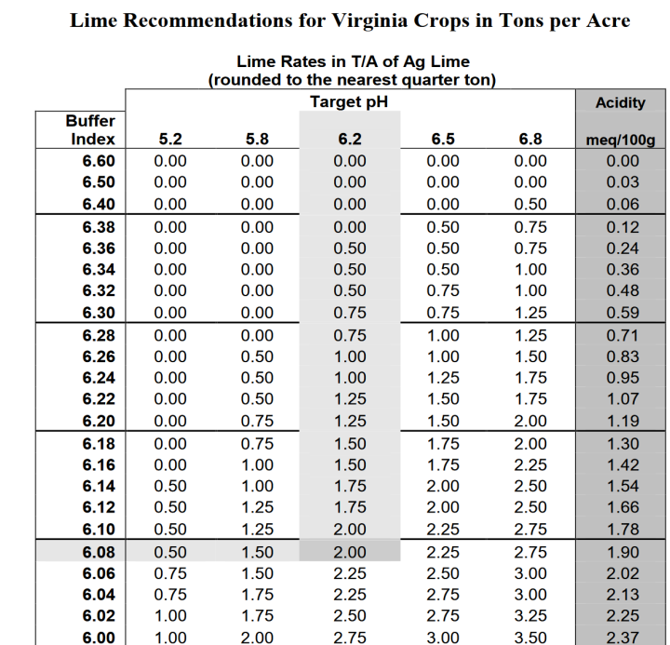
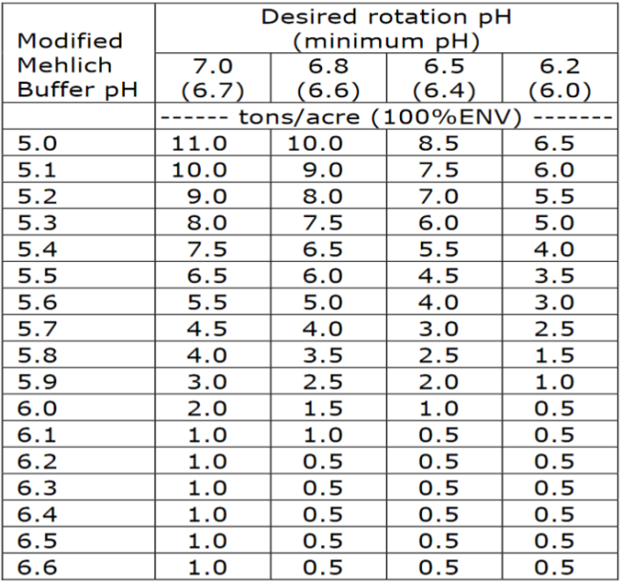
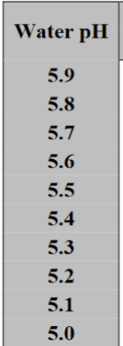
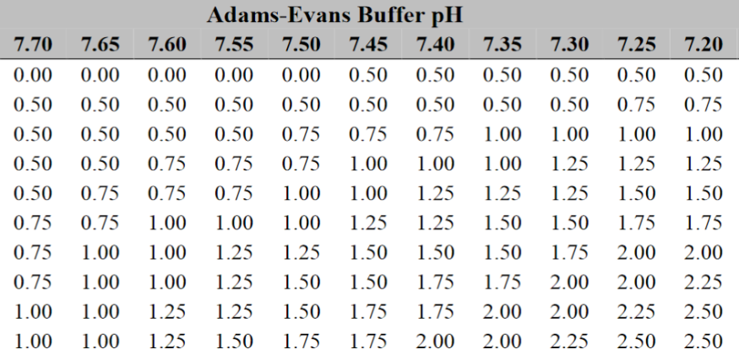
LGU lime recommendations
BpH lime recommendation table
Algorithm base on pH_{H2O} and BpH
Target final soil pH
Soil depth adjustment: 3”, 6” or 8”
Adjustment for mineral vs organic soils
Lime neutralizing value (NV) adjustment
Mehlich Buffer, Lime Rate tons per acre 100% ECCE.
University of Delaware
Fact Sheet 48, Lime rate tons per acre 100% ECCE.
Target pH 6.5 (0-8”), Lime Rate tons per acre 67% ECCE.
MASTPAWG
FRST Lime Project
February 23, 2023
Miller, 2023
Notes:
Lime recommendatios have beeen develop by Univ research around the US. They may be expressd as a simple talbe based on BpH
Or as algrorthim / table based on a tartget pH , adjustmenst fo depth, soil type, and uetralizing power.
Examp[le for three states using SMP, Mehlicha Adamds Evans buffers

Slide 26
Comparison of lime recommendations
Soil lime recommendations were evaluated on three soils from the Agricultural Laboratory Proficiency (ALP) program for three LGUs.
Lime rates vary, by BpH, LGU and calibration research.
Can lime rates be standardized?
Soil ID ¹ | SRS-2001 | SRS-2006 | SRS-2003
pH _{1:1 H2O} | 5.19 | 5.48 | 6.01
Sikora BpH | 6.65 | 6.50 | 6.85
AE BpH | 7.44 | 7.30 | 7.45
Calculated lime rate lbs/ac ²
Tri-State (OH-MI-IN) | 2100 | 3200 | 700
Clemson Univ | 1900 | 2100 | 1100
Univ Delaware | 2500 | 2800 | 1400
¹ Soil data source ALP program 2020, population median values.
² Recommendations based on a 3” depth, target pH of 6.5, and 100% ECCE.
MASTPAWG
FRST Lime Project
February 23, 2023
Miller, 2023

Slide 27
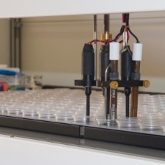
Soil BpH methods, Mid-Atlantic region
Lab BpH methods¹ are based on soil/buffer equilibration: stirring, settle-hold time, and measurement.
The Adam Evans (AE) BpH was originally developed for low CEC soils < 10, cmol kg⁻¹ dominate in 1:1 clay minerals and low SOM. Whereas, SMP (Sikora) was developed for soils CEC 10 - 25 cmol kg⁻¹ dominant in 2:1 soil clay minerals.
Response range for AE BpH is narrower 7.20 – 7.90 than SMP or Sikora BpH. Mehlich BpH (ME) range 5.1 – 6.6.
AE
Sikora ²
Mehlich
8.0
8.0
8.0
1.0
5.0
7.0
10.0
7.0
7.0
1.0
1.0
6.0
5.0
6.0
5.0
5.0
10.0
5.0
10.0
² Max range of lime rates 0-10 ton/ac
¹ Sikora, F. 2014. Soil test Methods for the Southeastern United States. Southern Cooperative Series Bulletin No. 419ISBN# 1­58161­419­5
MASTPAWG
FRST Lime Project
February 23, 2023
Miller, 2023
Notes:
Soil BpH methods methods base on short equilibation of the buffer with the soil
Follwed by determination of the change in pH using H ISE
Adams Evans
Buffer ranges and example at right

